Slide 1

ReLink: A Mobile-Based Similarity Matching Framework for Efficient Lost Item Recovery in Educational Institutions
Monika M -192521435
Rashmi Naurene -192521357
ITA0301 MOBILE COMPUTING
Course Faculty : Dr. Terrance Frederick Fernandez,
Professor, SIMATS Engineering, SIMATS

Slide 2

AGENDA
Abstract
Introduction
Literature Review
Problem Statement
Objectives
Proposed Methodology
Applications
Results & Analysis
Conclusion
Future Enhancements
References

Slide 3
ABSTRACT
ReLink is a mobile-based lost and found application that enables users to digitally report and recover misplaced belongings within a college campus.
The system compares lost and found reports using multiple attributes such as images, category, colour, brand, location, and date to identify potential matches.
An explainable similarity matching algorithm generates a confidence score and provides users with the reasons behind each suggested match.
The application incorporates secure verification, private communication, and administrative analytics to improve the efficiency and reliability of the recovery process.

Slide 4
INTRODUCTION
Misplacing personal belongings is a common problem in educational institutions, often leading to inconvenience, stress, and loss of valuable items.
Traditional lost and found methods rely on notice boards, social media posts, or manual enquiries, which are often slow and unorganised.
The absence of an intelligent matching mechanism makes it difficult for users to identify whether a reported found item belongs to them.
A centralized mobile application can significantly improve communication, reduce recovery time, and increase the chances of successfully returning lost items.

Slide 5
LITERATURE REVIEW
S.NO | DETAILS OF THE JOURNAL | ALGORITHM / METHODOLOGY USED | ADVANTAGES | DIS ADVANTAGES
1 | Feng, Y., Wang, Y., Wang, X., Zhao, B., Bi, J., Han, S. and Luo, Y., 2026. Food additive lens: an on-device AI application for real-time science-based consumer education on food additives using retrieval-augmented generation. Digital Discovery, 5(3), pp.1172-1190. | The proposed system implements a three-agent AI architecture consisting of a Food Category Classifier, Hybrid Additive Identifier, and Explanation Generator. It utilizes an on-device quantized Llama 3.2 3B Large Language Model, Retrieval-Augmented Generation (RAG), Optical Character Recognition (OCR), and Model-View-ViewModel (MVVM) architecture | • Preserves user privacy by performing all AI processing offline on the device. • RAG reduces hallucinations by grounding responses in authoritative FDA and USDA databases. • Generates explainable and context-aware information instead of simple predictions. | • Requires powerful mobile hardware to efficiently execute on-device AI models. • Large AI models consume considerable device storage and memory. • The system is specialized for food additive analysis and requires domain adaptation for other applications.
2 | Prashanth, G. K., U. Uday Kumar, B. G. Premasudha, N. L. Rajesh, and N. Vinothini. "Mobile Technology for Efficient Lost and Found Item Retrieval Using GIS Based Approach." In 2025 3rd International Conference on Smart Systems for applications in Electrical Sciences (ICSSES), pp. 1-5. IEEE, 2025. | GIS-based mobile application integrating Firebase, Esri Maps, real-time GPS location services, proximity-based notifications, and a Fuzzy Matching Algorithm to compare lost and found reports based on similarity. | Integrates GIS for accurate location tracking. • Fuzzy matching improves the probability of identifying related lost and found items. • Real-time notifications enhance recovery speed. | Continuous GPS usage may increase battery consumption. • Requires a stable internet connection for real-time synchronization. • Limited explainability of the matching results compared to newer AI-based approaches.

Slide 6
LITERATURE REVIEW
S.NO | DETAILS OF THE JOURNAL | ALGORITHM / METHODOLOGY USED | ADVANTAGES | DIS ADVANTAGES
3 | Allheeib, Nasser Ibrahim. "Mafqodat: A Secure and Safe Mobile Application to Retrieve Lost Items in Educational Institutes." In 2024 12th International Conference on Information and Communication Technology (ICoICT), pp. 368-373. IEEE, 2024. | The proposed system is a mobile-based lost and found platform developed for educational institutions. It enables users to report lost and found items, communicate through the application, verify ownership before returning an item, and send location radius-based notifications to users near the reported location. | Provides a dedicated platform for managing lost and found items within a university campus. Enables direct communication between the owner and finder through the application. | • Relies mainly on user-reported information and manual verification. • Does not implement intelligent similarity matching or image-based comparison. • Matching depends on users identifying relevant posts themselves.
4 | Karthik, P., Rajesh, R., Nithin Kumar, T. and Kiran, S., 2025, July. Content-Based Fashion Image Retrieval in Android Applications using Artificial Neural Networks. In 2025 8th International Conference on Computing Methodologies and Communication (ICCMC) (pp. 1568-1573). IEEE. | The proposed system implements a Content-Based Image Retrieval (CBIR) framework using Convolutional Neural Networks (CNNs) and Artificial Neural Networks (ANNs) for feature extraction. The extracted image features are compared using Cosine Similarity and Euclidean Distance | • Achieves high retrieval accuracy (approximately 95.99%). • Deep learning extracts rich visual features such as colour, texture, and shape. • Provides fast and intuitive image-based searching instead of relying on text keywords. | • Requires a large labelled dataset and significant computational resources for training. • Model performance depends on the quality and diversity of training images. • Primarily focuses on fashion products and may not generalize well to other object categories without retraining.

Slide 7
PROBLEM STATEMENT
Existing lost and found systems require users to manually browse through numerous reports, making the recovery process time-consuming and inefficient.
Most available solutions lack intelligent matching techniques and therefore fail to accurately identify similar lost and found items.
The absence of a secure verification process increases the possibility of false ownership claims and incorrect item handovers.
There is a need for an intelligent mobile application that automates item matching while ensuring transparency, security, and ease of use.

Slide 8
OBJECTIVES OF THE CAPSTONE PROJECT
To develop a mobile application that allows users to digitally report lost and found items in a structured manner.
To implement an intelligent similarity matching system that compares reports using multiple item attributes.
To provide an explainable confidence score that helps users understand why a particular match has been suggested.
To ensure secure ownership verification before an item is returned to its rightful owner.

Slide 9
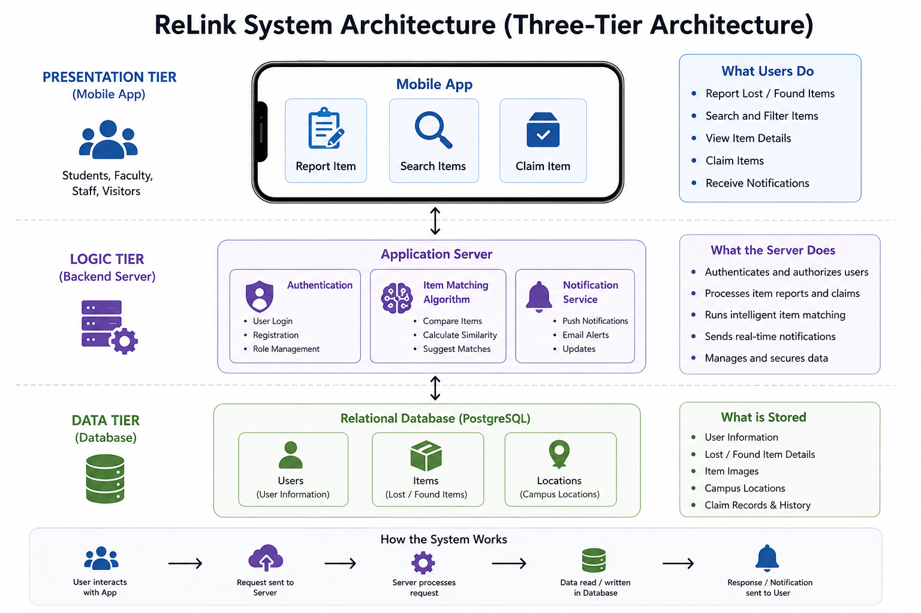
PROPOSED METHODOLOGY – ARCHITECTURE DIAGRAM

Slide 10
APPLICATIONS OF THE RESEARCH
The proposed system can be implemented in colleges and universities to efficiently manage lost and found belongings.
The application can also be adopted in corporate offices to simplify the recovery of employee belongings.
Large public environments such as shopping malls, hospitals, libraries, airports, and railway stations can use the platform to organise lost property management.
The scalable architecture enables the system to be deployed across multiple institutions with centralized administration.

Slide 11
PROJECT DEMO

Slide 12
DESCRIPTION ABOUT THE DATASETS USED (IF AVAILABLE / OR ELSE DELETE THIS)
1 POINT
1 POINT
1 POINT
1 POINT

Slide 13
STEPS OF PROPOSED METHODOLOGY
1 POINT
1 POINT
1 POINT
1 POINT

Slide 14
STEPS OF PROPOSED METHODOLOGY
1 POINT
1 POINT
1 POINT
1 POINT

Slide 15
STEPS OF PROPOSED METHODOLOGY
1 POINT
1 POINT
1 POINT
1 POINT

Slide 16
RESULTS AND DISCUSSION
1 POINT
1 POINT
1 POINT
1 POINT

Slide 17
RESULTS AND DISCUSSION
1 POINT
1 POINT
1 POINT
1 POINT

Slide 18
COMPARISON AND ANALYSIS
1 POINT
1 POINT
1 POINT
1 POINT

Slide 19
CONCLUSION
1 POINT
1 POINT
1 POINT
1 POINT

Slide 20
FUTURE ENHANCEMENTS
1 POINT
1 POINT
1 POINT
1 POINT

Slide 21
REFERENCES
1 POINT
1 POINT
1 POINT
1 POINT

Slide 22
THANK YOU

